Slide 1
Then and now: The evolving PBM model
ANTONIO CIACCIA
February 2024

Slide 2
My road
Antonio Ciaccia
President, 3 Axis Advisors
After years of government affairs work at the Ohio Pharmacists Association, a few anecdotal reimbursement complaints from pharmacies grew into a loud chorus that pushed me into the bowels of the prescription drug supply chain.
Severe pharmacy margin pressure in Ohio Medicaid managed care during a period of massive state drug spending growth drove me to search for where the money was going.
Years of learning and digging led to the uncovering of hundreds of millions of dollars in hidden drug costs and a nationwide reckoning for drug pricing reform.
Launched 46brooklyn Research in 2018 to publish and translate publicly available drug pricing data for free.
Launched 3 Axis Advisors in 2019 to help others solve drug pricing riddles using more extensive data research and analysis. Clients include Medicaid Fraud Control Units, government agencies, provider groups, research firms, technology companies, law firms, investment analysts, employers, benefit consultants, private foundations, and industry disruptors.
2024 All rights reserved.

Slide 3
Our drug distribution system
Primary players
Drug manufacturers
Drug wholesalers
Pharmacies
Pharmacy benefit managers (PBMs)
Health insurers
Other players
Group purchasing organizations
Pharmacy services administrative organizations
Repackagers/relabellers
Rebate aggregators
Benefits brokers/consultants
2024 All rights reserved.

Slide 4
Our drug distribution system
Primary players
Drug manufacturers *
Drug wholesalers *
Pharmacies *
Pharmacy benefit managers *
Health insurers *
Fortune 50
#1 Walmart *
#2 Amazon *
#5 UnitedHealth Group ****
#6 CVS Health ****
#9 McKesson *
#11 AmerisourceBergen *
#12 Costco **
#14 Cardinal Health *
#15 Cigna ****
#22 Elevance ***
#24 Kroger **
#25 Centene ***
#27 Walgreens **
#38 Pfizer *
#40 Johnson & Johnson *
#42 Humana ***
2024 All rights reserved.

Slide 5
Our drug distribution system
While there are many smaller, independent players at each layer of the drug channel, it is reasonable to assume that the primary goal of the largest publicly traded companies is to increase returns to shareholders – it is their true fiduciary obligation.
This is important to remember – not because profit incentive is wrong – but because it’s vital to understand the incentives that drive supply chain behavior.
In our efforts to control prescription drug costs, a proper calibration of incentives is necessary to ensure efficient spending and maintain robust access to pharmaceuticals.
2024 All rights reserved.

Slide 6
The origins of the PBMs
The origins of PBMs
During World War II and the Korean conflict, wages were frozen but benefits were not. As a result, the benefit moved from being a "fringe" to an active component of an employee’s compensation
See 1942 Stabilization Act
Historically, pharmacy benefits were lumped with vision and dental plans as complementary to medical benefits and treated as "riders" that could be added to the major medical package
Before the 1970s, drug prices lagged behind the consumer price index (CPI) as well as the growth in healthcare costs.
Pharmacy reimbursement with an insurer would require the submission of a paper claim (universal claim form) and on very cheap claim, patients often wouldn’t complete the paperwork (shoe box claims estimated at ~8-10% of the market)
2024 All rights reserved.
Notes:
Whilst Pfizer was providing the medicines needed for the Union war effort, a young cavalry commander named Colonel Eli Lilly was serving in their army. A trained pharmaceutical chemist, Lilly was an archetype of the dynamic and multi-talented 19th century American industrialist, who after his military career, and trying his hand at farming, set up a pharmaceutical business in 1876. He was a pioneer of new methods in the industry, being one of the first to focus on R&D as well as manufacturing.
Another military man in the drugs business was Edward Robinson Squibb, who as a naval doctor during the Mexican-American war of 1846–1848 threw the drugs he was supplied with overboard due to their low quality. He set up a laboratory in 1858, like Pfizer supplying Union armies in the civil war, and laying the basis for today’s BMS.
The Thalidomide scandal of 1961 prompted an increase in the regulation and testing of drugs before licensing, with a new amendment to US Food and Drug Administration (FDA) rules demanding proof of efficacy and accurate disclosure of side-effects for new medications (the Kefauver-Harris Amendment) being implemented in 1962. Likewise, the 1964 Declaration of Helsinki put greater ethical structures on clinical research, clearly cementing the difference between production of scientific prescription medicines and other chemicals.

Slide 7
What changed?
In the late 1960s (1968), the United Auto Workers collective bargaining led to the adoption of ‘card plans’ for prescription drugs
In card plans, the insurance company, an insurer or PBM contracts with pharmacies.
Under a master contract, pharmacies may choose to accept or reject their involvement and, depending on the size and breadth of the employer, the contracts may be regional or nationwide.
Claims processing at this time was more like a credit card then the modern claims processing we think of (two-way communication)
2024 All rights reserved.
Notes:
The emphasis is on volume purchasing of pharmacy services and wide access to pharmacies. Chain, discount, and mail-order pharmacies that can offer volume price discounts and access within five miles of physician groups or hospitals have competitive advantage over independent pharmacies. Regional contracts level access in remote areas, and, in these cases, providers are judged on access first and discounts second.
This move saved money

Slide 8
The 1980s
First mail-order pharmacies begin to work with PBMs to offer savings
At this time, there wasn’t really a discount on retail pharmacy costs, this changed with Express Scripts negotiating rates in the 1980s
1987 Real-time electronic claim processing begins with eligibility verification at the point-of-sale (two-way communication of claim and clinical information)
Drug Utilization Review
2024 All rights reserved.

Slide 9
Early Efforts of Modern PBMs
2024 All rights reserved.
Source: PCS Health Systems, June 1999.
Notes:
https://www.ncbi.nlm.nih.gov/books/NBK559746/

Slide 10
OBRA ‘90
Created by the Omnibus Reconciliation Act of 1990 (OBRA 1990), the Medicaid Drug Rebate Program helps lower Medicaid spending on outpatient prescription drugs by ensuring states receive discounts similar to those provided to private purchasers.
Drug utilization review (DUR) is a process required by federal law in the Omnibus Budget Reconciliation Act of 1990 (OBRA 90) to assure that prescriptions for covered outpatient drugs are appropriate, medically necessary, and not likely to result in adverse medical results.
Prospective DUR
Maintain health records
Counsel people on new prescriptions
2024 All rights reserved.

Slide 11
Early PBM Merger Activity
In 1993, the pharmaceutical market was jolted by major pharmaceutical manufacturers' purchases of the three largest PBMs.
Merck & Co. through a $6.6 billion purchase of Medco Containment Services
Eli Lilly & Co. acquired PCS Health Systems for $4.1 billion,
and SmithKline Beecham acquired Diversified Pharmaceutical Services (DPS) for $2.3 billion
Subsequently, Caremark entered into agreements with Pfizer and Bristol Myers-Squibb, and ValueRx allied with Pfizer.
2024 All rights reserved.
Notes:
https://www.annualreviews.org/doi/10.1146/annurev.publhealth.20.1.361

Slide 12
Regulatory Oversight
The Federal Trade Commission (FTC) took interest in manufacturer acquisitions of PBM services.
Lilly and PCS entered into a consent decree with the FTC requiring PCS to provide an open formulary option and to prevent information acquired by PCS on rival drug manufacturers' prices and practices from being revealed to the parent company
FTC required that Lilly appoint a Pharmacy and Therapeutics Committee, in which the majority of members would hold no affiliation with PCS or Lilly
GAO investigated Merck-Medco acquisition
Between 1998 and 2003, the manufacturers severed ownership of their PBMs
2024 All rights reserved.
Notes:
In a related inquiry, a US General Accounting Office (GAO) report revealed that, since the negotiations for the Merck-Medco merger began, the PBM's formularies substantially increased their representation of Merck drugs (14). Further, the GAO also reported that Medco removed some products that competed with those of its parent pharmaceutical company. The GAO also scrutinized the formulary of SmithKline Beecham's Diversified Pharmaceutical Services (DPS) and found that, after the merger, the number of SmithKline Beecham drugs on the DPS formulary and their cost designations remained largely the same. Given the mixed results of its inquiry, the GAO called on the FTC to continue monitoring the potentially anticompetitive practices of manufacturer-owned PBMs (14, 43).
The most recent development in the FTC antitrust inquiry is Merck's agreement to a settlement with the FTC regarding its ownership of Medco (52). The settlement is similar to the 1994 agreement between the FTC and Eli Lilly & Co., discussed above. Merck agreed to offer its health-plan clients an “open formulary” option that allows patients unrestricted access to prescription drugs. (Of course, that does not mean that the clients will necessarily choose the open formulary, especially if the price differential is significant.) Formulary drugs would be selected by a Pharmacy and Therapeutics Committee that is independent of the parent firm. Like Eli Lilly & Co., Merck agreed to a firewall, which would keep competitors' drug prices confidential and nonpublic. As yet, the FTC has not reached agreement with SmithKline Beecham in its investigation of that company's PBM, DPS (20).
https://www.annualreviews.org/doi/10.1146/annurev.publhealth.20.1.361

Slide 13
The Affordable Care Act
The 2010 Affordable Care Act impacted all aspects of U.S. healthcare – directly or indirectly
For PBMs, the ACA requires PBMs that manage drug coverage under a contract with a Medicare Part D drug plan or qualified health benefits plans offered through a state exchange to disclose certain financial and prescription drug dispensing information relating to their client contracts.
1) “the aggregate amount, and the type of rebates, discounts, or price concessions that the PBM negotiates that are attributable to patient utilization under the plan,”
2) “the aggregate amount of the rebates, discounts, or price concessions that are passed through to the plan sponsor,”
3) “the total number of prescriptions that were dispensed,” and
4) “[t]he aggregate amount of the difference between the amount the health benefits plan pays the PBM and the amount that the PBM pays retail pharmacies, and mail order pharmacies”
Furthermore, the medical loss ratio (MLR) requirements have potential impacts to the vertical integration that has occurred since the law’s passage
2024 All rights reserved.

Slide 14
Horizontal Consolidation
It began with a series of consolidations in which some PBMs acquired pharmacies and other PBMs
Big 3 PBMs estimated to make up 80-85% of marketplace
But that’s just one layer within large, vertically integrated enterprises
Source: https://communityoncology.org/wp-content/uploads/2022/02/COA_FL_PBM_Expose_2-2022.pdf
2024 All rights reserved.

Slide 15
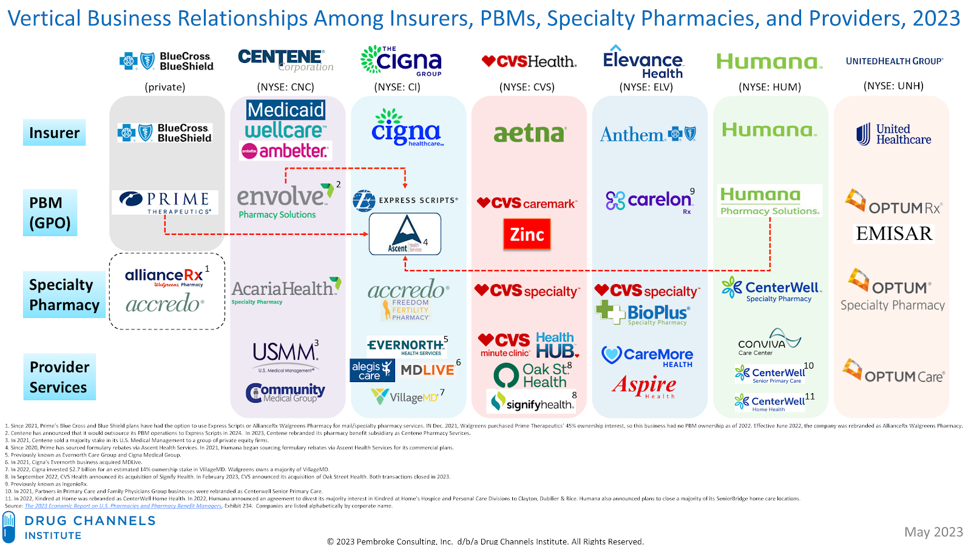
Vertical Consolidation
Today, vertical consolidation has created silos offering a breath of pharmacy services across the U.S. drug supply chain
Source: https://www.drugchannels.net/2023/05/mapping-vertical-integration-of.html
2024 All rights reserved.

Slide 16
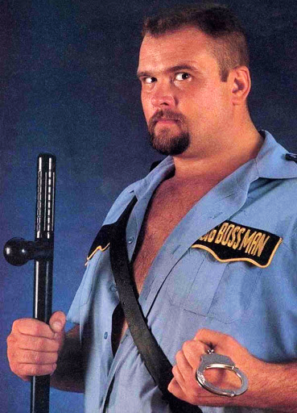
In a world of bogus, inflated drug prices, PBMs are supposed to be the good guys
Decades ago, as more medicines entered the market and prescription drug costs grew, plan sponsors sought ways to holding spending accountable.
PBMs were brought in to act as friction against drugmakers, wholesalers, pharmacies, and other members of the drug supply chain.
2024 All rights reserved.

Slide 17
The evolving role of PBMs
As PBMs worked to control one end of the drug supply chain, they began to develop business interests in the very marketplace that they were hired to control.
Today, PBMs advertise that they are the only entity working to control prescription drug costs, but data shows that PBM profits generated off prescription drug transactions heavily distorts their incentives to control drug spending for their clients.
2024 All rights reserved.

Slide 18
Examining PBM tactics and incentives

Slide 19
The system is built on “fake prices”
List prices for prescription drugs are wildly overinflated relative to their actual cost.
PBMs use those list prices (AWP) as the basis for their pricing guarantees to pharmacies and plan sponsors.
Brand name drugs have high AWPs that are offset by negotiated rebates and discounts that make those net prices much lower.
Generic drugs have high AWPs (derived from brand drugs) that in no way reflect the actual prices pharmacies pay to acquire those drugs.
In both regards, the “actual” prices of both brand and generic drugs are hidden from the plan sponsor and patient.
Those who claim to provide “savings” on prescription drugs often quantify the value of those savings based on artificially inflated list prices that are borne out of industry dysfunction.
2024 All rights reserved.

Slide 20
The fallout of fake prices: Brands
$100
Patient (pre-deductible, cash)
Price discrimination is a strategy that charges customers different prices for the same product based on what the seller thinks they can get the customer to agree to
PBM and drug manufacturer negotiate a net price, but the extent to which that true net price is captured by the payer depends on the payer’s access to information and negotiating leverage
Hidden rebates are the key enabler allowing the drug supply chain to capture benefits of drug price discrimination
Small Employer
Drugmaker List price
Large Employer
Part D Plan Sponsor
$50
Big4 Negotiated Price
Drugmaker Net price
Medicaid
$0
2024 All rights reserved.

Slide 21
Drugmaker discounts and rebates are growing faster than list prices.
2024 All rights reserved.
Source: https://www.drugchannels.net/2024/01/tales-of-unsurprised-us-brand-name-drug.html

Slide 22
“Rebates” are just the tip of the iceberg
https://www.statnews.com/pharmalot/2018/08/16/rebates-fees-drug-prices/
2024 All rights reserved.

Slide 23
“Rebates” are whatever the PBMs and insurers say they are
As scrutiny has increased on the relation between rebates and higher list prices – and the degree with which those rebates are being passed on to patients and plan sponsors – PBMs and insurers have been recategorizing “rebates” and building new layers in the supply chain to hide the discounts from regulators and payers.
2024 All rights reserved.

Slide 24
The rise of the rebate aggregators
https://www.benefitspro.com/2021/04/15/cautionary-tale-plan-sponsors-losing-manufacturer-rebate-dollars-to-pbms-through-rebate-aggregators/
2024 All rights reserved.

Slide 25
How the “rebate” retention game works
Pharma Revenue Category
Rebate aggregators leverage the size of their managed population to extract price concessions from drug makers
The three largest PBMs all own or are affiliated with a rebate aggregator (CVS/Zinc, ESI/Ascent, Optum/Emisar)
Rebate aggregators use the tools in the green box to reclassify and selectively share money received from pharma
Only a few of the manufacturer revenue categories are passed through to the PBM
Clients get rebate guarantees, but on a meaningless per claim basis, which is impossible to audit back to the aggregator
An employer at best only has visibility into a few of the manufacturer revenue categories
The higher list prices rise, the more price concessions a PBM can collect and retain
Standard Rebate Definition
Incentive rebates categorized as mail-order purchase discounts
Credits
Market Share Incentives
Promotional Allowances
Commissions
Market Share Utilization
Drug pull-through programs
Implementation Allowances
Rebate Submission Fees
Formulary Placement Fees
Administrative Fees
Inflation Caps/ Pricing Protection
Price Concessions
Performance-based Incentives
Data Fees
Volume-based Incentives
2024 All rights reserved.

Slide 26
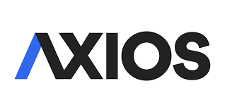
What’s baked into high drug prices?
Drugs in competitive classes suffer from massive disconnects between list prices and net prices.
PBMs often have patients pay the list price, while keeping the discounted rate for themselves.
Any drug pricing reform that does not address this dysfunctional system structure omits one of the primary mechanisms that inflate the prices of medicine.
https://www.axios.com/fda-biosimilar-insulin-viatris-semglee-interchangeable-d8ffac02-c4e7-4282-b087-1ea32e432c72.html
2024 All rights reserved.

Slide 27
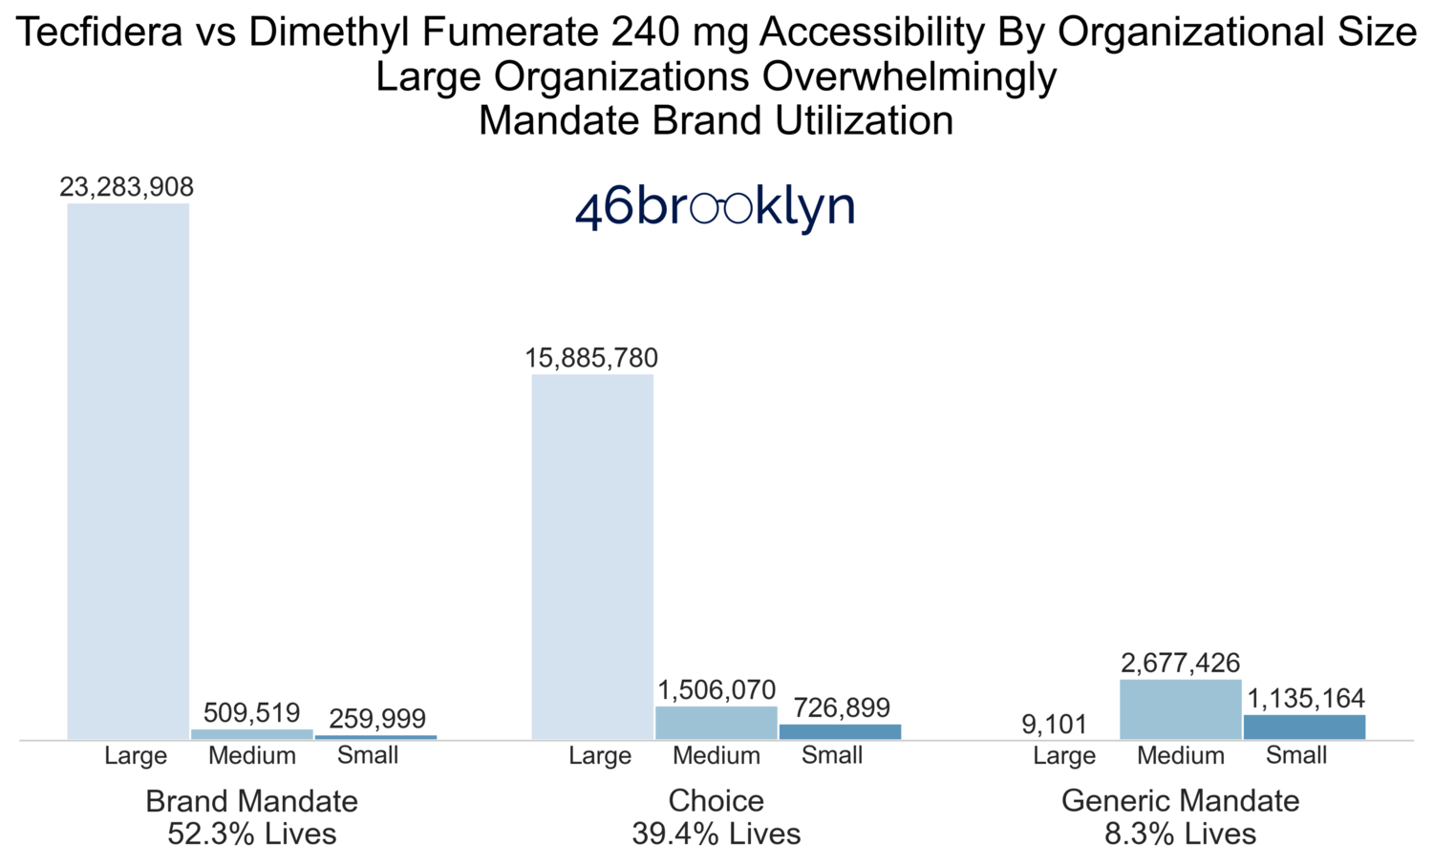
Even when cheap generics are available, the largest insurers and PBMs force patients to take far more expensive brands
In Q3 2021:
Brand Tecfidera WAC: $8275/mo
Generic NADAC: $184/mo
Despite brand Tecfidera being around $8,000 more expensive than the generic, more than half of seniors are in Part D plans that require them to pay for the brand.
Sources: https://www.46brooklyn.com/research/2021/12/1/tecfidera https://www.marketwatch.com/story/grandma-and-grandpa-arent-going-to-figure-this-one-out-prescription-drug-savings-vanish-in-the-medicare-shuffle-11639152848
2024 All rights reserved.

Slide 28
Where are those savings for small U.S. employers?
We had the opportunity to analyze data for a group of small self-insured employers
Total group spending on brand name drugs exceeded $110 million in 2018
On that spend, we identified only ~$5 million in rebates
In a world free from drug price discrimination, where all employers received the “best commercial price,” their rebates would have been roughly 6x higher
PBMs (and/or affiliated insurance companies) appear to have retained these rebates
~
FSS is a proxy for “best commercial price”
~
Source: 3 Axis Advisors analysis
2024 All rights reserved.

Slide 29
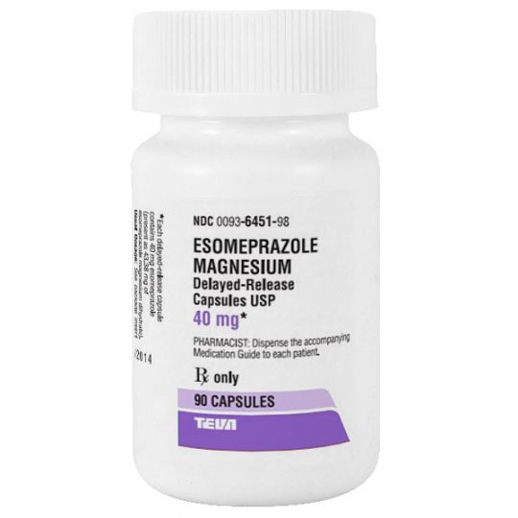
The fallout of fake prices: Generic drugs
In the U.S., every drug has multiple, different prices
Average Wholesale Price (“AWP”) and Wholesale Acquisition Cost (“WAC”) are both unilaterally set by the manufacturer
Not dictated by competitive market forces
National Average Drug Acquisition Cost (“NADAC”) is based on a voluntary national survey of pharmacy invoice costs
Is dictated by competitive market forces
Alabama Actual Acquisition Cost (“AAC”) is based on a mandatory survey of pharmacy invoice costs
Is dictated by competitive market forces
Ohio Medicaid pursuing their own AAC survey under PBM redesign
Generic Nexium’s AWP is 47 times higher than it’s AAC
Source: MediSpan Price Rx, Elsevier Gold Standard Drug Database, CMS, 3 Axis Advisors
2024 All rights reserved.

Slide 30
Spread pricing hits home in Ohio
Ohio Medicaid audit revealed $244 million in spread pricing from Q2 2017 to Q1 2018
Spread pricing = the difference between the reimbursements paid to pharmacies and the rates reported back to the payer; PBM retains the difference
Ohio’s state Auditor David Yost conducted his own audit, and found that spread equated to 31.4% of gross generic spending in Ohio Medicaid managed care
https://www.axios.com/data-showing-pbm-medicaid-drug-price-manipulation-1533059892-c2a97bcd-8874-42c2-a161-503e89666678.html https://www.bloomberg.com/graphics/2018-drug-spread-pricing/ https://ohioauditor.gov/news/pressreleases/Details/5042 https://stories.usatodaynetwork.com/sideeffects/cost-cutting-middlemen-reap-millions-via-drug-pricing-data-show/
2024 All rights reserved.

Slide 31
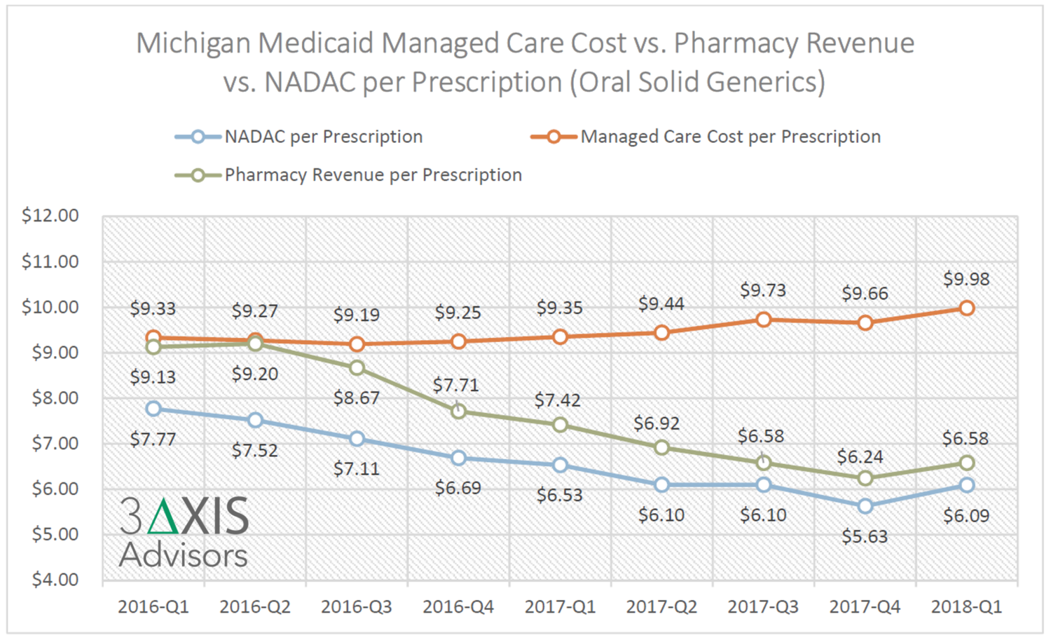
Ohio isn’t alone
3AA analysis of Medicaid managed care pharmacy claims in Michigan showed:
Drug costs going down
Pharmacy margins going down
PBM spreads going up
State costs going up
Spread pricing allows pharmacy-affiliated PBMs to shift traditional pharmacy margins to the PBM side of their enterprise.
https://www.3axisadvisors.com/projects/2019/4/28/analysis-of-pbm-spread-pricing-in-michigan-medicaid-managed-care
2024 All rights reserved.

Slide 32
The books are still cooked
“Pharmacy benefit managers are making millions of dollars through Ohio's Medicaid program for which Medicaid can't account.
That's because the PBMs are collecting controversial cash ‘clawbacks’ from pharmacies after the state has closed its books on prescription-drug purchases for more than 3 million poor and disabled Ohioans, Medicaid Director Maureen Corcoran acknowledged Wednesday before a legislative watchdog panel.
So the actual cost of hundreds of thousands of Medicaid drug transactions as recorded by the state and reported to the federal government in recent years is inaccurately inflated.
Not only that, but PBMs also are violating at least the intent and spirit of an Ohio law banning clawbacks, as well as a measure mandating pass-through pricing, Corcoran said. The latter requires PBMs to charge the state the same price they pay pharmacists to fill a prescription for a Medicaid recipient.
After the Joint Medicaid Oversight Commission meeting, Corcoran added another revelation: The data on which Ohio Medicaid relies to set its payment rates — including how much state and federal taxpayers are assessed — likely are wrong as well.”
Reference: https://www.dispatch.com/story/news/2021/10/27/health-care-monopoly-raises-drug-costs-consumers-pharmacists-say-pbms-prescription-cvs-united-cygna/8513593002/
2024 All rights reserved.

Slide 33
Margin seeking: Brand specialty drug differential pricing
Percentage of Brand Drug Claims Filled by Affiliated Pharmacy
Florida Medicaid Managed Care Claims Data (excl. 340B)
2018-19 | Under $2,000 per Rx | Over $2,000 per Rx
Plan A | 0.6% | 60.2%
Plan B | 0.4% | 53.0%
Plan C | 0.3% | 18.2%
Plan D | 0.2% | 44.9%
Less
Expensive
More
Expensive
In Florida, specialty drugs are not only steered to affiliated pharmacies, but they are also more expensive at affiliated pharmacies!
https://www.3axisadvisors.com/projects/2020/1/29/sunshine-in-the-black-box-of-pharmacy-benefits-management
2024 All rights reserved.

Slide 34
More on margin seeking: Brand specialty drug differential pricing (Humira)
Less
Expensive
More
Expensive
If Florida Medicaid would have recognized the non-affiliated pharmacy cost on the claims within the affiliated pharmacies, over $1.5 million in savings would have been realized on Humira alone.
https://www.3axisadvisors.com/projects/2020/1/29/sunshine-in-the-black-box-of-pharmacy-benefits-management
2024 All rights reserved.

Slide 35
More on margin seeking: Differential generic drug pricing & steering
3AA’s small commercial payer data analyses also found steering to insurer/PBM-affiliated pharmacies with specialty generics.
With generics, the PBM can set the price it chooses to pay its affiliated pharmacy with no oversight due to opacity of price.
In 2018, PBMs directed more than half of $1,000+ generic claims to affiliated pharmacies and paid themselves a weighted average margin of $3,448 per claim.
The specialty pharmacy affiliated with Insurer #1 generated a third of its overall 2018 generic margin off 0.5% of its generic claims.
For expensive specialty generics, the markups were more than 150% higher at affiliated pharmacies vs non-affiliated pharmacies.
Percentage of Generic Drug Claims Billed and Claim Costs, Affiliated vs Non-Affiliated Pharmacies Small Commercial Payer Dataset (2018)
 | Generic drug Claims less than $1,000 |  |  | Generic drug Claims more than $1,000
 | % by affiliated pharmacy | Markup per claim affiliated | Markup per claim other | % by affiliated pharmacy | Markup per claim affiliated | Markup per claim other
Insurer #1 | 5% | $55.02 | $20.36 | 40% | $4,765 | $1,530
Insurer #2 | 39% | $13.13 | $7.82 | 81% | $3,000 | $1,263
Insurer #3 | 4% | $35.74 | $12.87 | 40% | $2,759 | $1,053
Insurer #4 | 4% | $77.45 | $17.54 | 47% | $2,448 | $1,468
Insurer #5 | 3% | $33.52 | $12.43 | 85% | $2,272 | $302
Total | 11% | $26.02 | $15.72 | 51% | $3,448 | $1,339
2024 All rights reserved.

Slide 36
The big problem
PBMs were hired to work on behalf of plan sponsors to maximize value in pharmaceutical purchases and lower costs
PBMs make money in so many different, opaque ways off the prescription drug transaction, that it has become impossible to fully trust their incentives
Vertical integration has further distorted those incentives
PBMs have successfully lowered net costs for themselves, but the rub has been the lack of full value being passed through to plan sponsors, and further, they have propped up artificially inflated prices, creating more necessity for them to provide relief for those prices
PBM price manipulation through spread pricing, effective rate contracting, prescription underpricing and overpricing, patient steering, and more puts pharmacy access at risk, compromises actuarial soundness of capitation rates, and undermines medical loss ratio calculations
2023 All rights reserved.
2024 All rights reserved.

Slide 37
antonio@3axisadvisors.com
Twitter: @A_Ciaccia
2023 All rights reserved.
2024 All rights reserved.

Slide 38
Special drugs, special prices

Slide 39
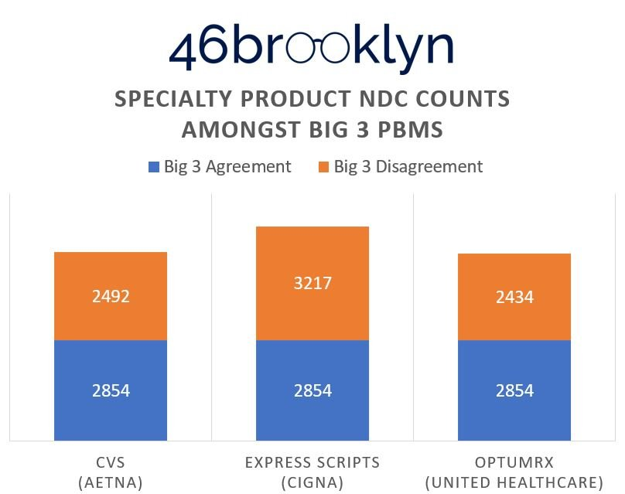
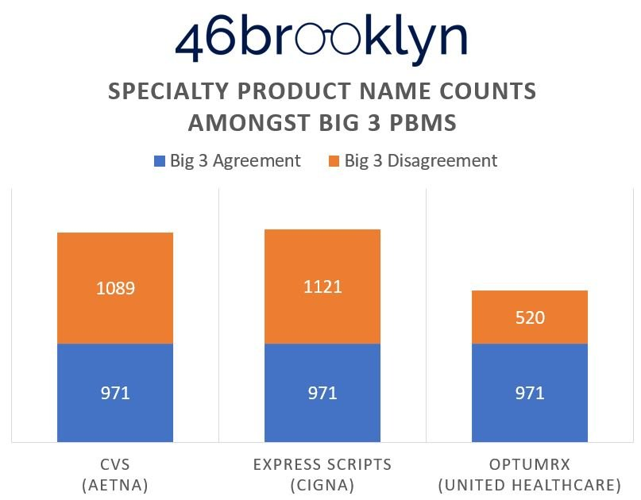
What makes specialty drugs so special?
Big PBMs can’t seem to agree.
Reference: https://www.46brooklyn.com/research/2023/5/10/how-pbms-distort-and-undermine-specialty-drug-pricing-guarantees-blac
2023 All rights reserved.
2024 All rights reserved.

Slide 40
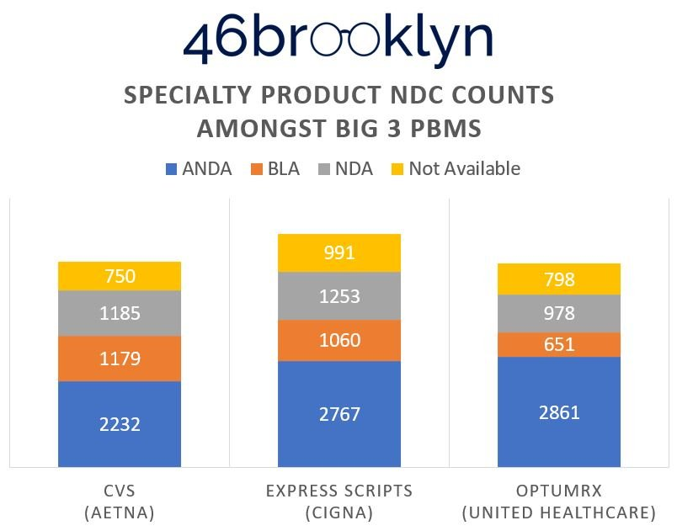
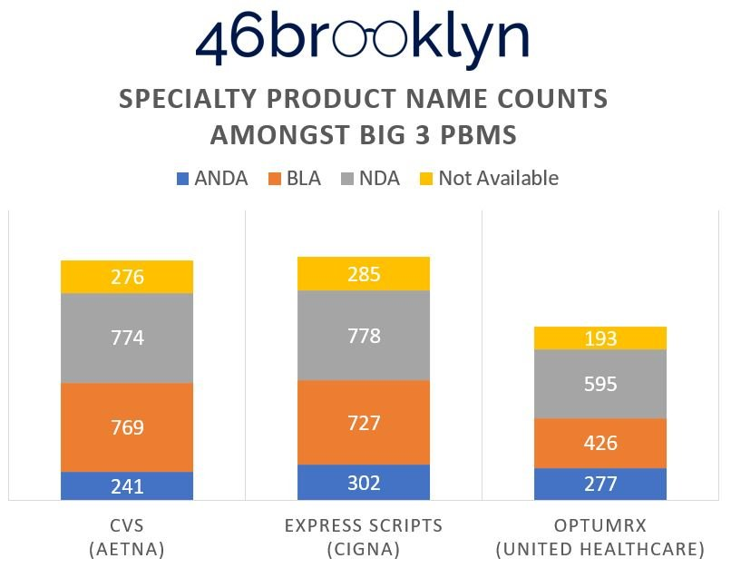
But what do they agree on?
Big PBMs agree that cheap generic drugs are special.
Reference: https://www.46brooklyn.com/research/2023/5/10/how-pbms-distort-and-undermine-specialty-drug-pricing-guarantees-blac
2023 All rights reserved.
2024 All rights reserved.

Slide 41
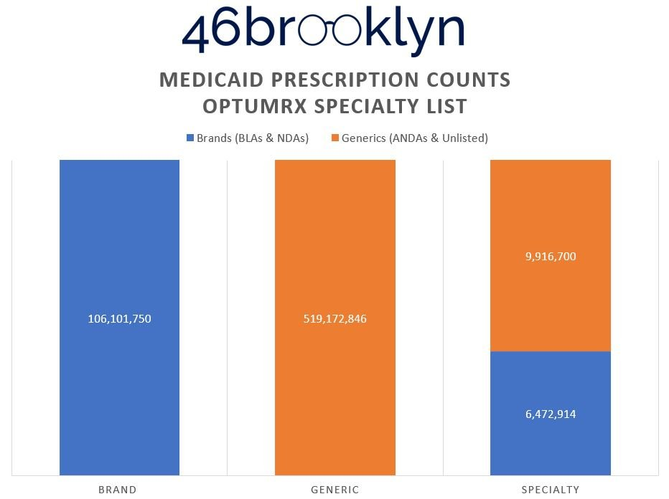
How special are generic drugs?
Generic drugs have an outsized impact on specialty pricing guarantees.
Reference: https://www.46brooklyn.com/research/2023/5/10/how-pbms-distort-and-undermine-specialty-drug-pricing-guarantees-blac
2023 All rights reserved.
2024 All rights reserved.

Slide 42
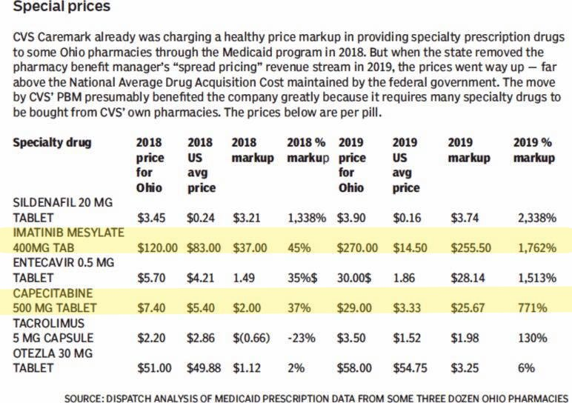
More on margin seeking: Differential generic drug pricing & steering
In Ohio, after spread pricing was eliminated in Medicaid, PBMs began overpaying pharmacies on specialty drugs, which PBMs tend to steer through their own pharmacies.
This enabled PBMs to margin-shift dollars from spread to specialty medications filled at their affiliated pharmacies.
These problems persist today, but are by no means unique to Ohio and by no means unique to Medicaid programs.
Reference: https://www.46brooklyn.com/research/2019/4/21/new-pricing-data-reveals-where-pbms-and-pharmacies-make-their-money; https://www.dispatch.com/news/20190430/ohio-medicaid-officials-to-crack-down-on-pbm-specialty-drug-practice
2023 All rights reserved.
2024 All rights reserved.

Slide 43
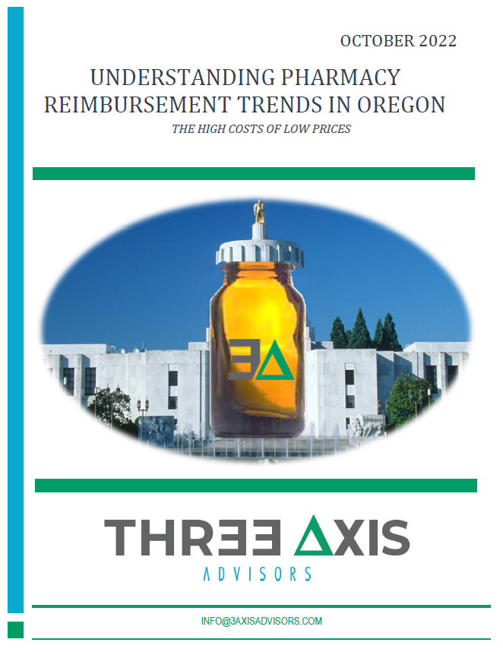
Our latest: Oregon
Drug prices in Oregon
2023 All rights reserved.
Source: https://www.3axisadvisors.com/projects/2022/10/27/understanding-pharmacy-reimbursement-trends-in-oregon

Slide 44
Lack of drug pricing transparency creates variability in experience
2023 All rights reserved.

Slide 45
What Oregon taught us: The business of pharmacy is a casino
2023 All rights reserved.
Source: https://www.3axisadvisors.com/projects/2022/10/27/understanding-pharmacy-reimbursement-trends-in-oregon

Slide 46
Losses are aplenty, but big scores determine profitability vs bankruptcy
18% of all claims are reimbursed below national average drug acquisition cost (NADAC)
Pharmacies don’t hit profitability until the 75th percentile of claims
The 5% of claims with highest profits are responsible for 62% ($455 of $731) of pharmacies' total accumulated profit
Meanwhile, the most profitable prescriptions (i.e. generic Gleevec, generic Tecfidera, generic Xeloda) are being disproportionately filled at PBM-affiliated pharmacies
The losses are greatest in the Medicaid managed care programs.
2023 All rights reserved.
Source: https://www.3axisadvisors.com/projects/2022/10/27/understanding-pharmacy-reimbursement-trends-in-oregon

Slide 47
Pharmacy profitability is highly inconsistent and inequitable
2023 All rights reserved.
Source: https://www.3axisadvisors.com/projects/2022/10/27/understanding-pharmacy-reimbursement-trends-in-oregon

Slide 48
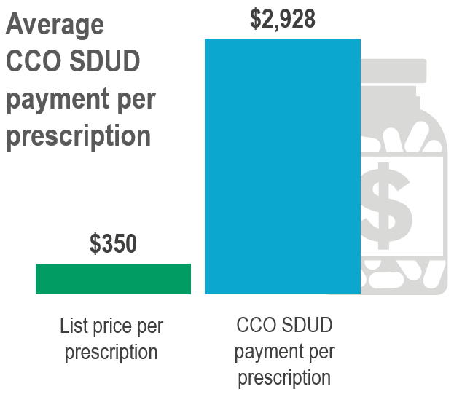
The dimethyl fumarate outlier case study in Oregon
Dimethyl fumarate 240 mg is the generic equivalent for Biogen’s blockbuster multiple sclerosis (MS) medication, Tecfidera®
Tecfidera® lost patent exclusivity in August of 2020.
The loss of exclusivity opened the drug up to generic competition shortly thereafter.
Prices to acquire the drug plummeted from where they’d been
2023 All rights reserved.
2024 All rights reserved.

Slide 49
A perspective view on prescription drug margin opportunity in Oregon
One Dimethyl Fumarate Prescription
1,011
Average Retail Pharmacy Rx
=
Oregon Study Pharmacies Did Not Dispense a Single Dimethyl Fumarate Rx in Oregon Medicaid
2023 All rights reserved.
2024 All rights reserved.

Slide 50
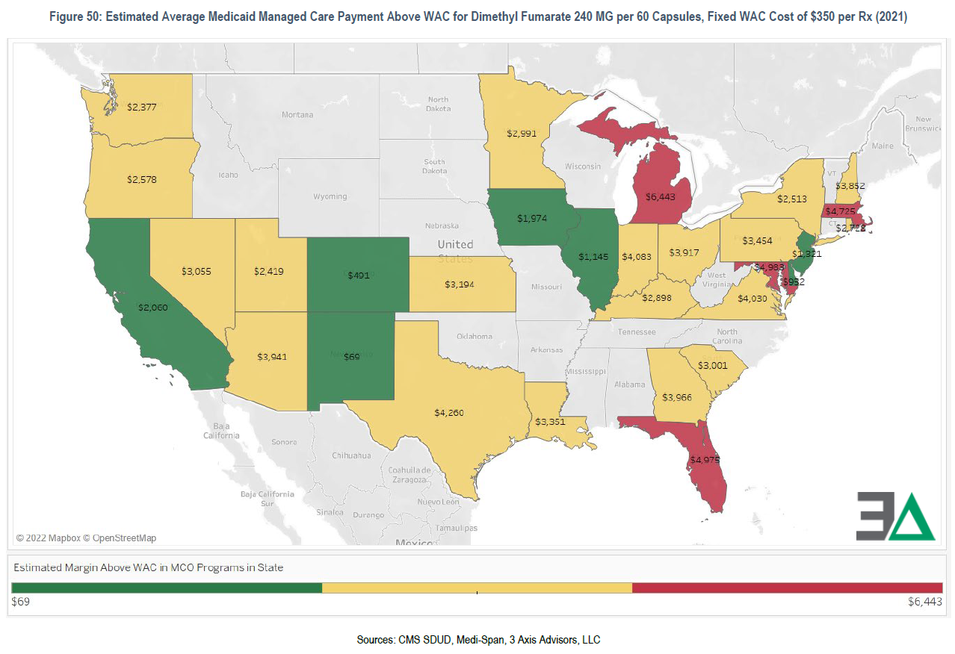
These findings are not unique to Oregon
2023 All rights reserved.
2024 All rights reserved.

Slide 51
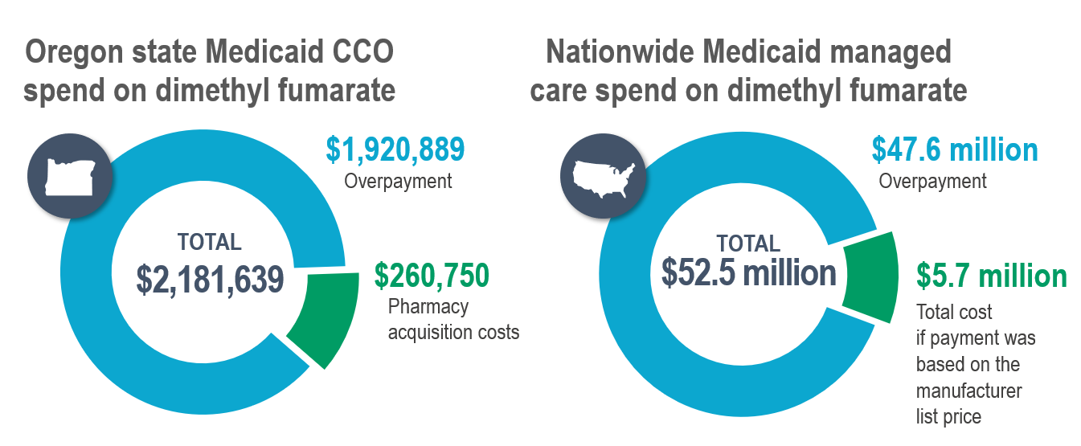
These findings are not unique to Oregon
2023 All rights reserved.
2024 All rights reserved.

Slide 52
More on margin seeking: Florida Medicaid MCO specialty pharmacy experience highlights the distortions
When comparing margins over NADAC in our Florida Medicaid analysis, it was overwhelmingly apparent that PBM-owned pharmacies received significantly more margin per prescription than traditional community pharmacies
Example: For Sunshine/Centene, 95% of all generic Gleevec 400 mg claims were filled at Acaria, Centene’s wholly owned specialty pharmacy, at a Margin over NADAC of $4,399 per claim
https://www.3axisadvisors.com/projects/2020/1/29/sunshine-in-the-black-box-of-pharmacy-benefits-management
2023 All rights reserved.
2024 All rights reserved.

Slide 53
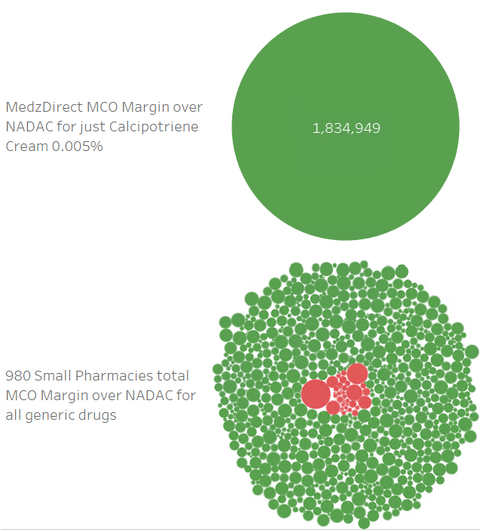
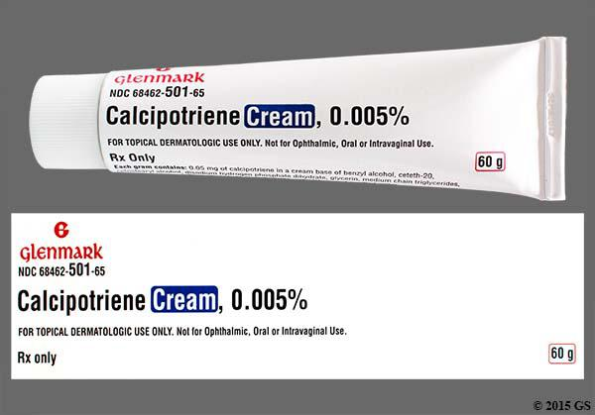
More on margin seeking
As an example, one Florida pharmacy followed the PBMs’ pricing signals on Calcipotriene Cream so well that the total profit reported on this one drug at just one pharmacy was equal to the total profit reported by Florida MCOs on all generic drugs dispensed at 980 of Florida’s Small Pharmacies.
https://www.3axisadvisors.com/projects/2020/1/29/sunshine-in-the-black-box-of-pharmacy-benefits-management
2024 All rights reserved.
2023 All rights reserved.

Slide 54
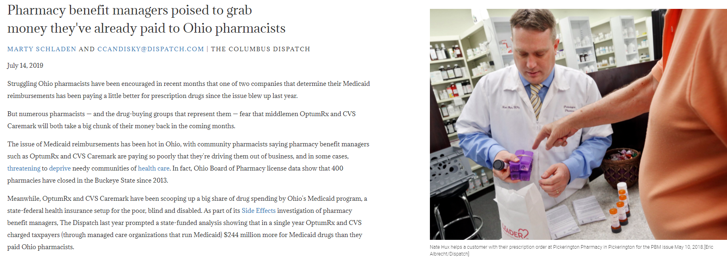
Rise of the effective rates
New phenomenon emerges where PBMs “overpay” pharmacies relative to their contract terms, building up on excess that can be clawed back at a later date
July 2019: Dispatch exposes these “effective rate clawbacks” as a new way that PBMs could arbitrage prescription drug claims. PBMs deny engaging in clawbacks; pharmacists warn each other that newly found margins are illusory
2023 All rights reserved.
Source: https://stories.usatodaynetwork.com/sideeffects/pharmacy-benefit-managers-poised-to-grab-money-theyve-already-paid-to-ohio-pharmacists/
2024 All rights reserved.

Slide 55
Rise of the effective rates
In Michigan, after spread pricing was eliminated in 2018, pharmacy reimbursements started rising (100%-125% increase under OptumRx and CVS/Caremark).
We later learned from pharmacies that much of the increased payments were clawed back.
In a pass-through pricing model, plan sponsors lose auditing visibility once reimbursement hits the pharmacy.
By overpaying at the point of sale, and clawing back excess payments later, PBMs have shifted spread to post-adjudication and out of sight from plan sponsors.
Reference: https://www.3axisadvisors.com/projects/2019/4/28/analysis-of-pbm-spread-pricing-in-michigan-medicaid-managed-care
2023 All rights reserved.
2024 All rights reserved.

Slide 56
Rise of the effective rates
“Elie Bahou says he remembers well when the order came down about a decade ago from the front office of his multibillion-dollar employer: Come up with new tactics to make more money.
‘We were sitting around one day looking for ways to generate more revenue and the C suite kept pushing us for more and more,’ Bahou recalled. ‘That was my employer trying to squeeze more and more and more dollars.’
Thus was born a concept most have never heard of: effective rate clawbacks.”
Reference: https://www.dispatch.com/story/news/2021/07/15/prescription-drug-clawbacks-pharmacy-benefit-managers-ohio/7817914002/
2023 All rights reserved.
2024 All rights reserved.

Slide 57
What can Mark Cuban teach us?

Slide 58
How Mark Cuban is dunking on the current PBM-centered model
3 Axis Advisors reviewed 674,034 generic claims from large plan sponsors across the country from 2023
22 PBM client files
Claims dates ranged from 1/1/23-10/31/23
Average price per Rx
PBM priced: $25.16 (does not included administrative fees)
MCCPDC: $15.78 (all fees included)
MCCPDC offered saving of 40%
MCCPDC Offers
40 % Savings
2023 All rights reserved.
2024 All rights reserved.

Slide 59
MCCPDC Top 10 Savings by Product/Single Claim
Product | Indication | Quantity | PBM Price | MCCPDC Price | Savings
Tolvaptan 15 MG | Kidney Disease | 90 | $ 40,448.48 | $ 4,666.50 | $(35,781.98)
Imatinib 400 MG | Cancer | 90 | $ 21,090.60 | $ 98.10 | $(20,992.50)
Fingolimod 0.5 MG | Multiple Sclerosis | 90 | $ 21,654.48 | $ 879.09 | $(20,775.39)
Imatinib 100 MG | Cancer | 270 | $ 17,440.92 | $ 84.60 | $(17,356.32)
Dimethyl Fumarate 240 MG | Multiple Sclerosis | 180 | $ 11,325.49 | $ 112.50 | $(11,212.99)
Posaconazole Oral 100 MG | Fungal Infection | 270 | $ 10,506.20 | $ 1,526.40 | $ (8,979.80)
Temozolomide 100 MG | Cancer | 42 | $ 8,303.17 | $ 441.18 | $ (7,861.99)
Abiraterone Acetate 250 MG | Cancer | 120 | $ 7,167.17 | $ 143.40 | $ (7,023.77)
Droxidopa 300 MG | Low Blood Pressure | 180 | $ 6,934.52 | $ 239.40 | $ (6,695.12)
Capecitabine 500 MG | Cancer | 300 | $ 6,653.56 | $ 111.00 | $ (6,542.56)
*Prices based on actual PBM client charge vs MCCPDC calculated price between January 1st 2023 and October 31th 2023
2023 All rights reserved.
2024 All rights reserved.

Slide 60
Cost Plus Pricing Top 10 Savings by Product/Utilization
Product | Indication | Rx Count | PBM Price | MCCPDC Price | Total Savings | Avg Saving Per Rx
Emtricitabine-Tenofovir 200-300 MG | HIV | 711 | $ 806,972.98 | $ 19,135.71 | $ (787,837.27) | $ (1,108.07)
Imatinib Mesylate 400 MG | Cancer | 72 | $ 418,318.24 | $ 3,385.20 | $ (414,933.04) | $ (5,762.96)
Rosuvastatin 10 MG | Cholesterol | 5,462 | $ 426,149.58 | $ 60,117.66 | $ (366,031.92) | $ (67.01)
Abiraterone 250 MG | Cancer | 72 | $ 308,702.08 | $ 8,941.20 | $ (299,760.88) | $ (4,163.35)
Hydroxychloroquine 200 MG | Antirheumatic | 2,318 | $ 289,073.31 | $ 47,856.50 | $ (241,216.81) | $ (104.06)
Fingolimod 0.5 MG | Multiple Sclerosis | 35 | $ 248,318.40 | $ 12,786.29 | $ (235,532.11) | $ (6,729.49)
Rosuvastatin 20 MG | Cholesterol | 3,739 | $ 265,435.98 | $ 43,590.36 | $ (221,845.62) | $ (59.33)
Mesalamine 1.2 GM | Ulcerative Colitis | 427 | $ 314,659.01 | $ 93,619.22 | $ (221,039.79) | $ (517.66)
Rosuvastatin 5 MG | Cholesterol | 3,448 | $ 245,481.89 | $ 35,578.46 | $ (209,903.43) | $ (60.88)
Dimethyl Fumarate 240 MG | Multiple Sclerosis | 32 | $ 141,604.63 | $ 1,840.50 | $ (139,764.13) | $ (4,367.63)
*Prices based on actual PBM client charge vs MCCPDC calculated price between January 1st 2023 and October 31th 2023
2023 All rights reserved.
2024 All rights reserved.

Slide 61
MCCPDC Humira Biosimilar
Humira was the top selling drug in the US at $37.2 Billion in 2022*
MCCPDC offers a biosimilar for the 40mg / 0.8ml Pen-injector: Yusimry
MCCPDC provides transparent, "all-in" net pricing through Yusimry manufacturer Coherus
Manufacturing Cost (Coherus) | Transparent Price Mark Up (15%) | Transparent Pharmacy Labor Price | Transparent Shipping Price
$495.01 | $74.26 | $10.00 | $55.00
*https://academic.oup.com/ajhp/article-abstract/80/14/899/7127651?redirectedFrom=fulltext
2023 All rights reserved.
2024 All rights reserved.

Slide 62
Humira Biosimilar
3 Axis Advisors analysis of 2023 plan sponsors yielded 832 claims for Humira 40mg
MCCPDC/Coherus biosimilar offers 88% cost reduction vs 2023 gross PBM charges for brand Humira
Total gross PBM charges: $6.55 million
MCCPDC biosimilar: $0.79 million
2023 All rights reserved.
2024 All rights reserved.

