Slide 1
Pharmacy Benefit Managers (PBMs): An Overview
Erin Trish, Ph.D. Co-Director, USC Schaeffer Center for Health Policy & Economics
California Assembly Select Committee on Biotechnology
February 6, 2024

Slide 2
Outline
Pharmacy Benefit Managers (PBMs):
Overview
Schaeffer Center research on market impact
Market consolidation

Slide 3
PBMs operate in a complex market
Copay assistance
R&D, marketing,
manufacturing
Wholesale distribution
Retail distribution
Copay/
cost
sharing
Wholesale price
Drug acquisition cost
Manufacturer
Pharmacy
Beneficiary
Wholesaler
Negotiated payment
Preferred placement on formulary
Rx drug coverage
Share of rebates from manufacturer
Managed drug benefits
Premium
Formulary payments, market share payments, rebates
Payment
PBM
Health Plan
Premium
Flow of Prescription Drugs
Flow of Services
Flow of Money
Plan Sponsor
Note: Simplified example of pharmaceutical distribution system. Pharmacies may be mail order or retail, and may be integrated with PBM. Plan sponsors may include employers, unions, managed care orgs, among others.

Slide 4
PBMs develop formularies and negotiate rebates with manufacturers
Medicare Part D Standard Benefit Design
Medicare Part D Actual Plan Design
CATASTROPHIC COVERAGE
5%
Government
80%
Plan
15%
Enrollee
25%
Manufacturer
70%
Plan
5%
Brand
COVERAGE
GAP
Enrollee
25%
Plan
75%
Generic
Enrollee
25%
Plan
75%
INITIAL
COVERAGE
PERIOD
Plan pays 75%
Enrollee pays 100%
DEDUCTIBLE
Enrollee
100%

Slide 5
Rebates have increased considerably
Intermediate Estimates
Source: Medicare Trustees Reports. Table IV.B8.

Slide 6
Rebate growth has helped keep Part D premiums low
Medicare Part D Beneficiary Premium
Source: Analysis using CMS Annual Releases of Part D National Average Bid Amount and Other Part C & D Bid Information.

Slide 7
Outline
Pharmacy Benefit Managers (PBMs):
Overview
Schaeffer Center research on market impact
Market consolidation

Slide 8
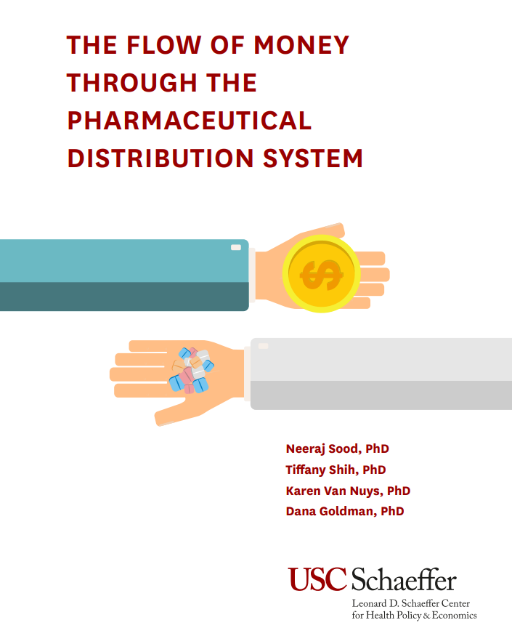
A considerable share of rebates and concessions are captured by intermediaries
Intermediaries capture $41 of every $100 spent on retail prescription drugs

Slide 9
PBMs can reduce net prices paid to manufacturers but savings may not be shared by consumers
Cost to the healthcare system remained flat
Net price received by manufacturers decreased
Source: Van Nuys et al. (2021).

Slide 10
The share of insulin expenditures captured by intermediaries is increasing
Middlemen’s share of total expenditures increased from 30% to 53% between 2014 and 2018
Health Plans
PBMs
Pharmacies
Wholesalers
Manufacturers

Slide 11
And many patients pay higher out-of-pocket costs
Effective Beneficiary Cost-Sharing as a Share of Net Price
2018 Standard Benefit Design
5%
Government
80%
Plan
15%
CATASTROPHIC COVERAGE
13%
$5,000 TrOOP
(~$8,418 TDC)
Excess OOP spending is greatest for the most competitive drug classes
Enrollee
35%
Manufacturer
50%
Plan
15%
COVERAGE
GAP
(Brand)
90%
Enrollee
25%
$3,750 TDC
Plan
75%
INITIAL
COVERAGE
PERIOD
Plan pays 75%
64%
Enrollee pays 100%
Enrollee
100%
$405 TDC
DEDUCTIBLE
Source: Lakdawalla and Li (2021). Notes: Benefit design is for non-LIS beneficiaries. The total drug costs (TDC) for the catastrophic limit is estimated for an average non-LIS beneficiary. True out-of-pocket (TrOOP) spending includes manufacturer-paid discounts.
Notes:
Now enrollees face only 25% coinsurance throughout, but the rules around who is covering the rest vary considerably.
But, when you look at actual plan design, it’s not quite that simple.

Slide 12
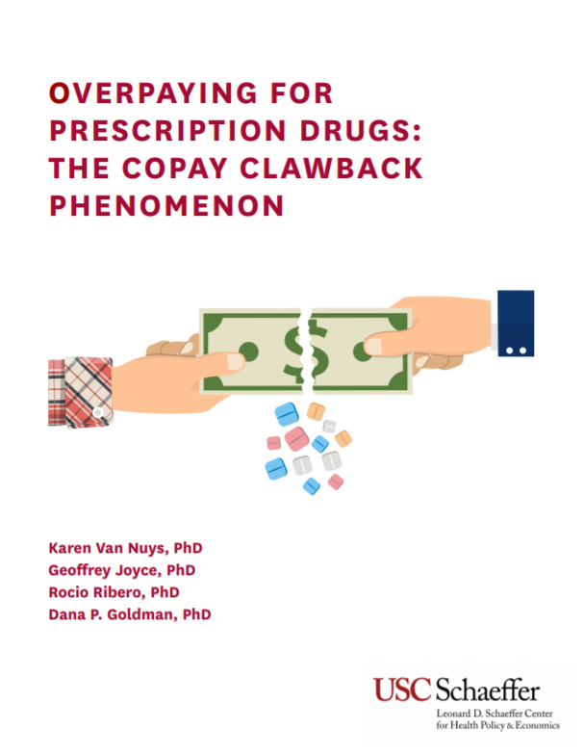
These overpayment issues exist for generic drugs too
In 2018, two US bills banning pharmacist gag clauses passed the US Senate and House, and were signed into law by then-President Trump. States such as California, Nebraska and New York have followed suit.

Slide 13
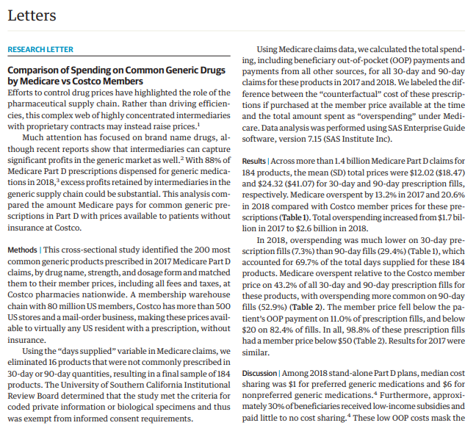
And Medicare often overpays for generic drugs
In 2018, Medicare overpaid by $2.6 billion (21%) on prescriptions for 184 common generics
Trish et al., “Comparison of Spending on Common Generic Drugs by Medicare vs Costco Members,” JAMA Intern Med. 2021; 181(10):1414-1416.

Slide 14
Pharmacy rebates have grown in recent years
2020: 4.8% of total Part D spending
2010: 0.01% of total Part D spending
Source: Medicare Advantage and Medicare Part D Proposed Rule (January 12, 2022).

Slide 15
Outline
Pharmacy Benefit Managers (PBMs):
Overview
Schaeffer Center research on market impact
Market consolidation

Slide 16
There is a long history of consolidation in pharmaceutical distribution
2003
’05
’06
’12
’15
’16
’18
’19
Pharmacies
Payers
PBMs
CVS Health
UnitedHealth Group
Cigna
Aetna
Express Scripts
Medco
Caremark Rx
Catamaran
Optum Rx
Pacificare Health
Advance PCS
Diplomat
Helios
2024 Fortune Rank:
#6
#5
#15

Slide 17
With the “Big 3” holding about 80% of the market
Source: Drug Channels Institute (2021). Notes: Market share is measured by total equivalent prescription claims managed, including claims at a PBM’s network pharmacies plus prescriptions filled by a PBM’s mail and specialty pharmacies. Includes discount card claims.

Slide 18
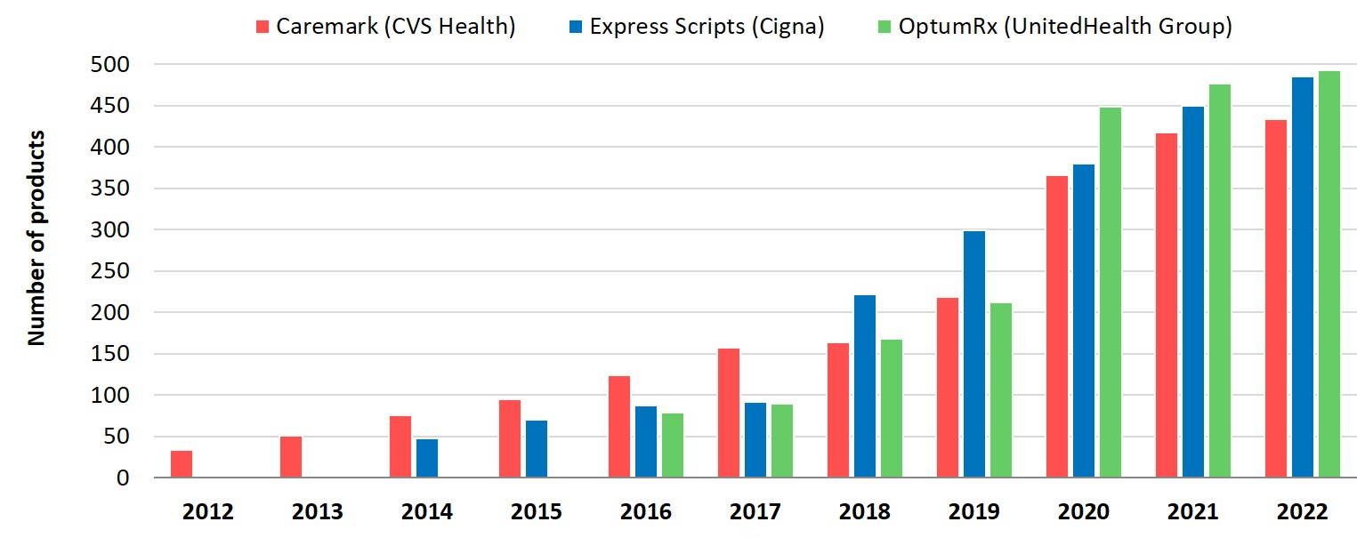
Alongside consolidation there is increased product exclusion
Products Excluded from Standard Formularies
Source: Adam Fein, Drug Channels Institute, January 19, 2022

Slide 19
Gross PBM profits have increased
$28.05
$25.15
$26.21
Mail-Order/ Specialty Pharma
Other Sources
Mfr Admin Fees
Rebates
Source: PBM Accountability Project "Understanding the Evolving Business Models and Revenue of Pharmacy Benefit Managers," 2021

Slide 20
And there is increasing concern about market distortion
72% of Part D formularies had a lower cost-sharing tier and 30% of Part D formularies had fewer utilization controls on at least one multisource branded drug compared with a generic equivalent (Socal et al., JAMA IM 2019)
PBMs charged Ohio’s Medicaid program a “spread” of more than 31% for generic drugs (Ohio Auditor General Report 2018)
Independent pharmacies’ gross profits and margins have declined (Fein, Drug Channels Institute 2018)

Slide 21
Summary
Rebates on prescription drugs have increased considerably over the last decade, but those savings are often not fully passed-through to consumers
Instead, an increasing share of drug expenditures is being captured by PBMs and other supply-chain intermediaries
The PBM industry has become increasingly consolidated and vertically integrated over the last decade
This has attracted the attention of the FTC and policymakers, in addition to market responses from employers, insurers, and new entrants

Slide 22
etrish@usc.edu

